Slide 1
Design and Analysis of Algorithm
UNIT-II
Greedy Algorithm
M Yogi Reddy
Assistant Professor,
Dept. of CSE,
School Of Technology,
GITAM(Deemed to be ) University,
Hyderabad.

Slide 2

Contents
Job Sequencing Algorithm
Knapsack Problem
Optimal storage on tapes [Huffman coding]
Minimum cost spanning trees
Single source shortest paths
1
2
3
4
5

Slide 3

Minimum Spanning Tree
Your friend at the ISP needs to choose where to build wires to connect all these cities to the Internet with fiber optic cable
B
6
3
E
2
1
C
A
1
9
5
7
4
D
8
She knows how much it would cost to lay cable wires between any pair of locations, and wants the cheapest way to make sure that every one is connected to server.

Slide 4
Minimum Spanning Tree
What do we need? A set of edges such that:
Every vertex touches at least one of the edges. (the edges span the graph)
The graph on just those edges is connected.
The minimum weight set of edges that meet those conditions.
Constraint: It should not form cycle

Slide 5
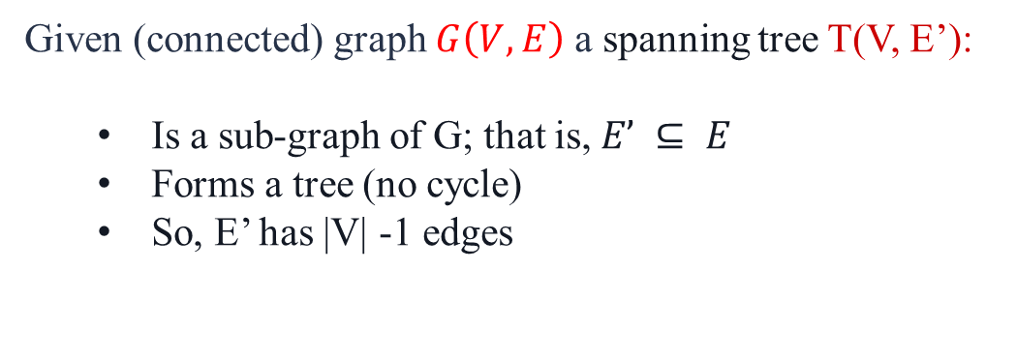
Minimum Spanning Tree
Given (connected) graph $G\left(V,E\right)$ a spanning tree T(V, E’):
Is a sub-graph of G; that is,$E’ ⊆ E$
Forms a tree (no cycle)
So, E’ has |V| -1 edges
Strategy for construction:
Add an edge of minimum cost that does not create a cycle (greedy algorithm)
Repeat |V| -1 times
Edges are weighted: find minimum cost spanning tree
B
3
A
4
6
7
9

Slide 6
Two Algorithms
Prim: (build tree incrementally)
Pick lower cost edge connected to known (incomplete) spanning tree that does not create a cycle and expand to include it in the tree
Kruskal: (build forest that will finish as a tree)
Pick lowest cost edge not yet in a tree that does not create a cycle. Then expand the set of included edges to include it. (It will be somewhere in the forest.)

Slide 7
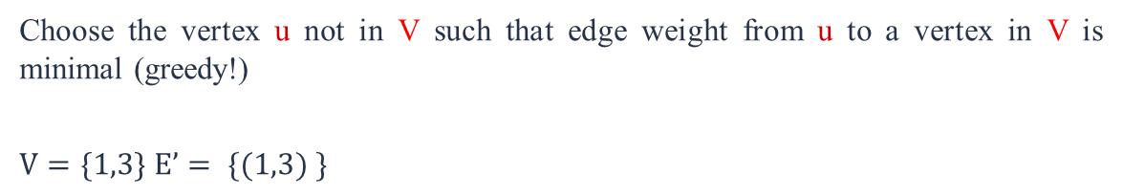
Prim’s algorithm
Starting from empty $T$ (tree), choose a vertex at random and initialize
$$V = \{1), E’ =\{\}$$
Choose the vertex u not in V such that edge weight from u to a vertex in V is minimal (greedy!)
$$V=\{1,3\} E’= \{(1,3) \}$$
V= {1,3,4} E’= {(1,3),(3,4)}
V={1,3,4,5} E’={(1,3),(3,4),(4,5)}
V={1,3,4,5,2} E’={(1,3),(3,4),(4,5),(5,2)}
V={1,3,4,5,2,6} E’={(1,3),(3,4),(4,5),(5,2),(2,6)}

Slide 8
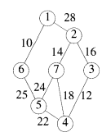
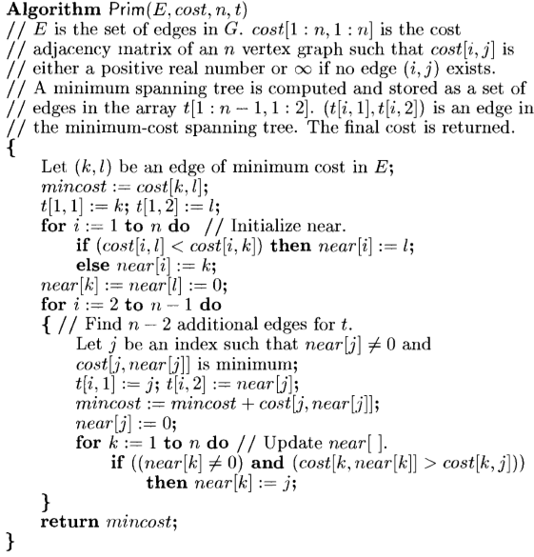
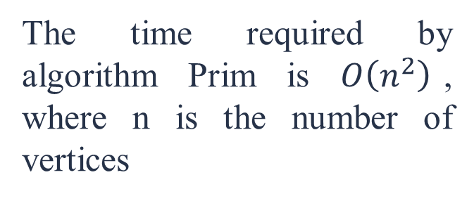

Algorithm
$$E=\{10,25,22,24,18,12,14,16,28\}$$
Minimum cost Edge (k, l)={(1,6)}
T=[1,6] i.e. (T(1,1)=1 and T(1,2)=6)
j | Near(j) | cost
1 | 6 | 10
2 | 1 | 28
5 | 6 | 25
The time required by algorithm Prim is $O\left(n^{2}\right)$, where n is the number of vertices

Slide 9
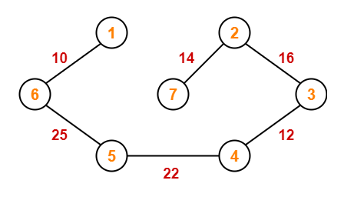
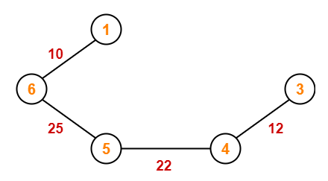
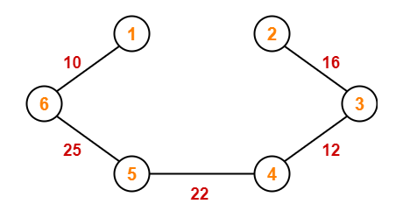
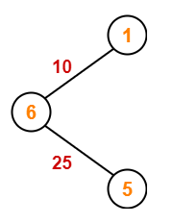
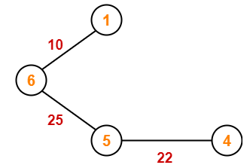
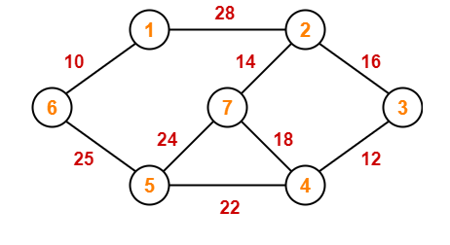
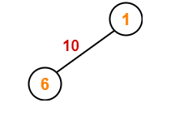
Questions
Construct the minimum spanning tree (MST) for the given graph using Prim’s Algorithm-
Total cost of Minimum Spanning Tree
$= 10 + 25 + 22 + 12 + 16 + 14$
$= 99 units$

Slide 10
Question
Apply Prim’s algorithm to find MST of the following graph. What is the sequence of processing the nodes.
7
1
6
1
2
2
6
6
2
3
4
6
2
3
4
7
5
4
3
5
4
3
5
6
6
7
5
1
3
6
4
2
5

Slide 11
Question
Find the no. of minimum cost spanning tree of the following graph.
10
10
10
1
3
40
1
3
40
1
3
20
40
20
20
5
5
5
2
40
2
4
2
4
40
4
30
30
30
For the given graph more than one spanning tree is possible but minimum cost will remain same
If the given graph contains more than one minimum cost spanning tree then in the given graph some edge weights are repeated.

Slide 12
Question
Consider the complete undirected graph with vertex set $V=\left(0,1,2,3,4\right).$ The weight matrix of the edge $\left(i,j\right)$ is given by
$$\begin{matrix}0 \\ 1 \\ \begin{matrix}2 \\ 3 \\ 4\end{matrix}\end{matrix} \left[\begin{matrix}0 \\ 1 \\ \begin{matrix}8 \\ 1 \\ 4\end{matrix}\end{matrix} \begin{matrix}1 \\ 0 \\ \begin{matrix}12 \\ 4 \\ 9\end{matrix}\end{matrix} \begin{matrix}8 \\ 12 \\ \begin{matrix}0 \\ 7 \\ 3\end{matrix}\end{matrix} \begin{matrix}1 \\ 4 \\ \begin{matrix}7 \\ 0 \\ 2\end{matrix}\end{matrix} \begin{matrix}4 \\ 9 \\ \begin{matrix}3 \\ 2 \\ 0\end{matrix}\end{matrix}\right]$$
$$0 1 2 3 4$$
What is the cost of MST such that 0 is the leaf node
1
1
2
4
3
0
3
4
2
2
4
3
4
3
1
2
1
0

Slide 13
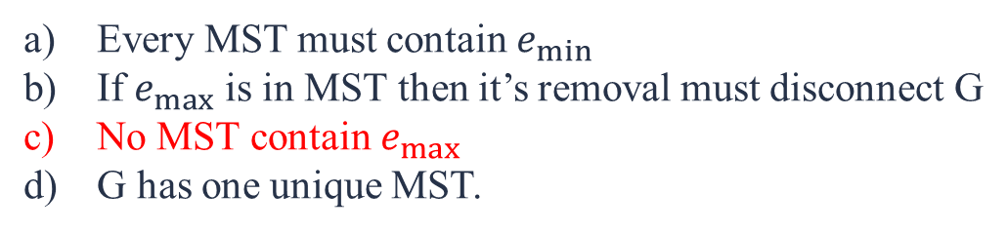
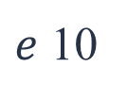
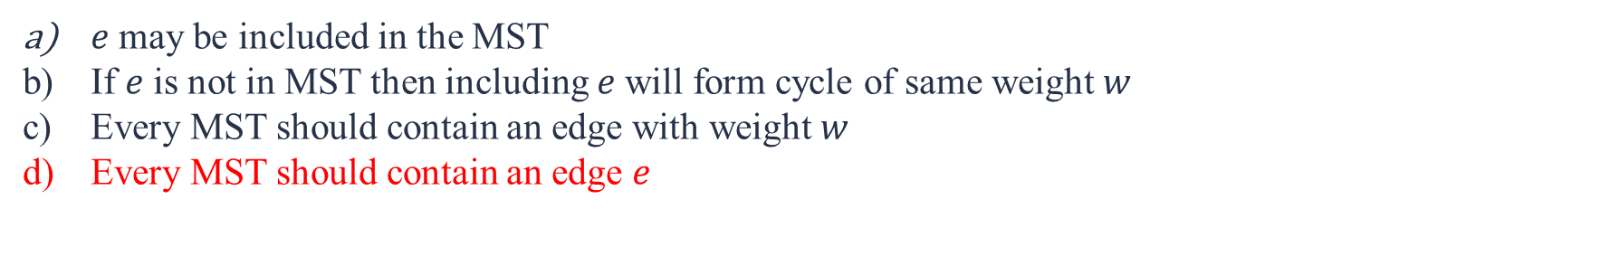
Question
$Q 1→$ Let $G\left(E,V\right)$be undirected connected graph with distinct edge weight. Let $e_{max}$be the edge with maximum weight and $e_{min}$be the edge with minimum weight then which of the following is false.
Every MST must contain $e_{min}$
If $e_{max}$ is in MST then it’s removal must disconnect G
No MST contain $e_{max}$
G has one unique MST.
$Q 2→$Let $G\left(E,V\right)$be undirected connected graph with $n$ vertices. Let $w$ be the minimum edge weight among all and $e$be a specific edge with weight $w$. Which of the following is false.
10
1
3
40
$e$ may be included in the MST
If $e$ is not in MST then including $e$will form cycle of same weight $w$
Every MST should contain an edge with weight $w$
Every MST should contain an edge $e$
10
$e$ 10
5
2
4
50
10

Slide 14
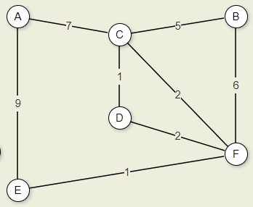
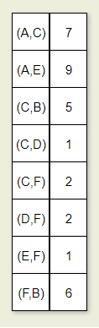
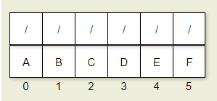
Kruskal’s Algorithm
Kruskal's algorithm is a simple, greedy algorithm.
First partition the set of vertices into | V | disjoint sets, each consisting of one vertex.
Then process the edges in order of weight.
An edge is added to the MCST, and two disjoint sets combined, if the edge connects two vertices in different disjoint sets.
This process is repeated until only one disjoint set remains.
A | B | CD | E | F
A | B | CD | EF
A | B | CDEF

Slide 15
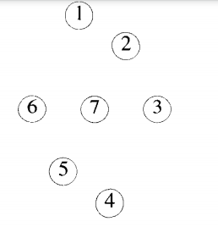
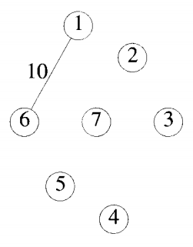
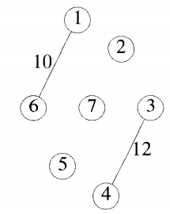
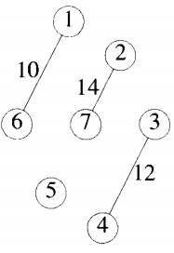
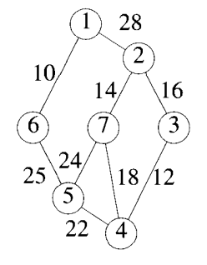
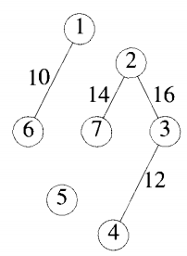
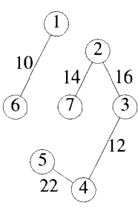
Example
25

Slide 16
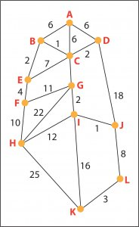
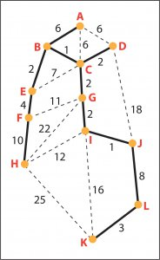
Question
Total Cost=1+1+2+2+2+2+3+4+6+8+10

Slide 17
Heap
A heap is a binary tree that can be of two types:
Min heap:
The element of each node is greater than or equal to the element at its parent. The minimum value element is at the root.
Max heap:
The element of each node is less than the element at its parent. The maximum value element is at the root.

Slide 18
Heap Construction
Using Min Heap
35, 33, 42, 10
Step 1 − Create a new node at the end of heap.
Step 2 − Assign new value to the node.
Step 3 − Compare the value of this child node with its parent.
Step 4 − If value of parent is less than child, then swap them.
Step 5 − Repeat step 3 & 4 until Heap property holds.
35
33
10
33
33
10
33
42
35
42
42
35
35
10

Slide 19
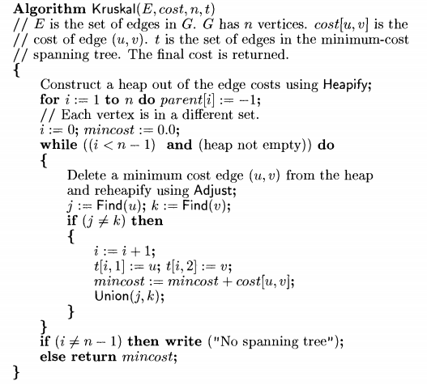
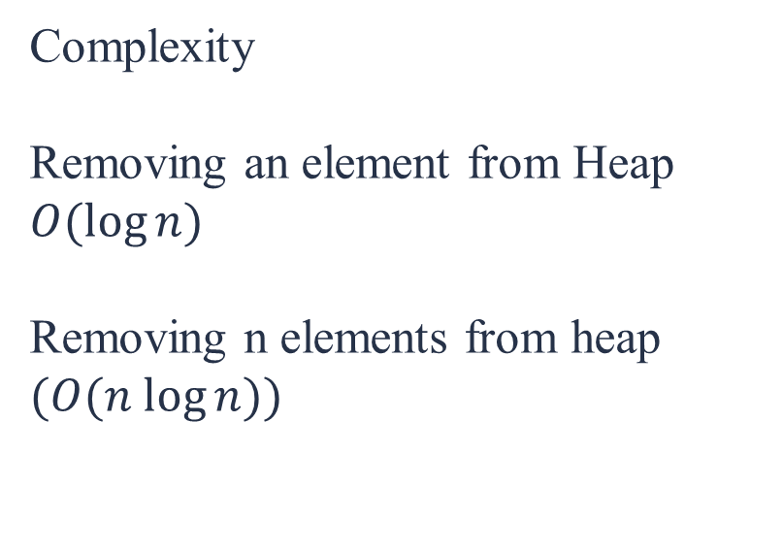

Algorithm
Complexity
Removing an element from Heap $O(log⁡n)$
Removing n elements from heap $(O(n log⁡n))$
$$O((E\log{V}))$$

Slide 20
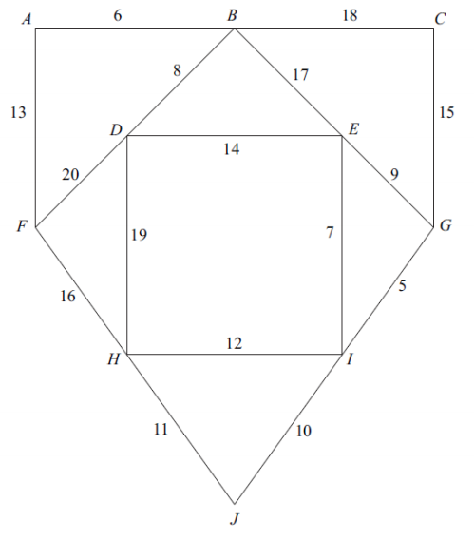
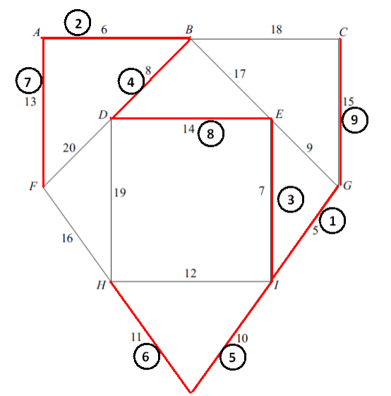
Question
What is the cost and sequence of Minimum spanning tree using Kruskal’s algorithm.

Slide 21
Theorem
Theorem 1: Kruskal's algorithm generates a minimum-cost spanning tree for every connected undirected graph $G$.
Note: In the middle of the Kruskal algorithm sometime we get disconnected graph. But for Prim’s algorithm we always get connected graph

Slide 22
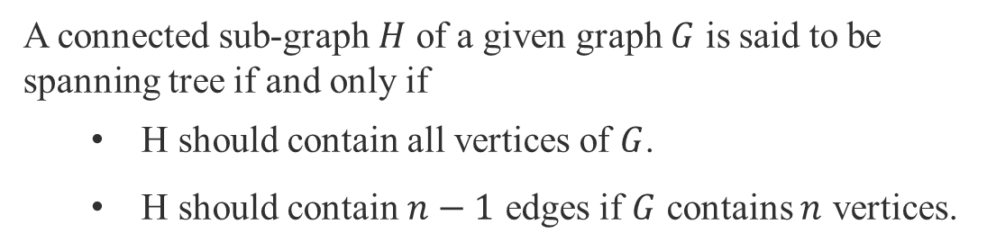
Spanning Tree
A connected sub-graph $H$ of a given graph $G$ is said to be spanning tree if and only if
H should contain all vertices of $G$.
H should contain $n−1$ edges if $G$ contains $n$ vertices.
3
Feasible Solutions | Cost
1-> (2, 3) | 11
2-> (1,3) | 5
3-> (1,2) | 10
1
2
2
8
3

Slide 23
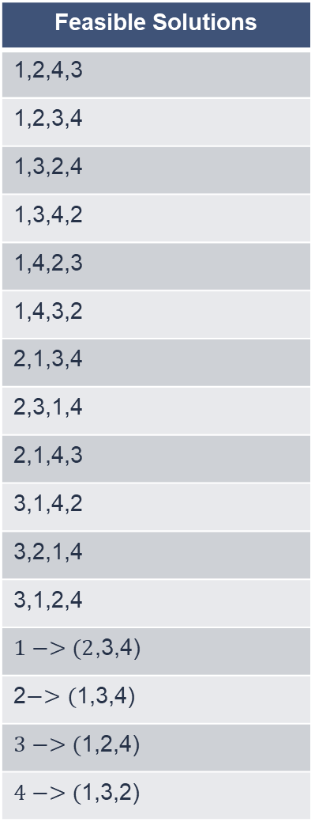
Spanning Tree
Feasible Solutions
1,2,4,3
1,2,3,4
1,3,2,4
1,3,4,2
1,4,2,3
1,4,3,2
2,1,3,4
2,3,1,4
2,1,4,3
3,1,4,2
3,2,1,4
3,1,2,4
$1−>(2$,3,4)
2$−>($1,3,4)
$3−>($1,2,4)
$4−>($1,3,2)
A connected sub-graph $H$ of a given graph $G$ is said to be spanning tree if and only if
H should contain all vertices of $G$.
H should contain $n−1$ edges if $G$ contains $n$ vertices.
3
1
2
6
2
8
4
3
9
4

Slide 24
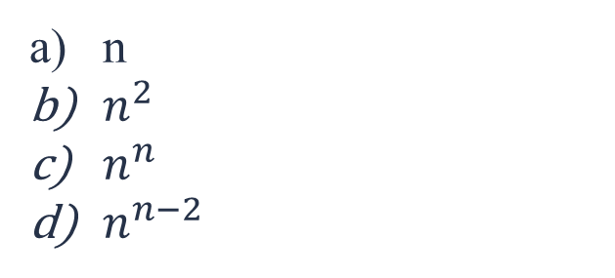
Question
What is the no. of spanning trees in a complete graph with n vertices.
n
$n^{2}$
$n^{n}$
$n^{n−2}$
The number of distinct minimum spanning trees for the weighted graph is
2
6
10
7

Slide 25



